Slide 1
Intro to RQDA
Prabin Raj Shakya
prabinrs.github.io

Slide 2
Steps in Analysis of Qualitative Data
Preparation
Coding
Data Attributes
Codes abstraction
Code plotting and sharing
Theory building

Slide 3
1. Preparation
RQDA – based analysis
#1. Install R, RSQLite, GTK, RQDA
#2. Transform textual data into individual ASCII or .txt files
#3. Launch RQDA
#4. Create a new project
#5. Upload all .txt files into RQDA
Advantages and Disadvantages
All data files are transportable online via emails,
Dropbox, or using a device (e.g. USB stick)
Ease of logistics handling when moving offices,
involving multiple researchers
Not all researchers are familiar with R

Slide 4

Let’s start with:
What is R
Free
Software for
statistical computation
and graphics

Slide 5

What is R Studio
1) A company
2) A software program that makes working in R easier
IDE: Integrated Development Environment

Slide 6
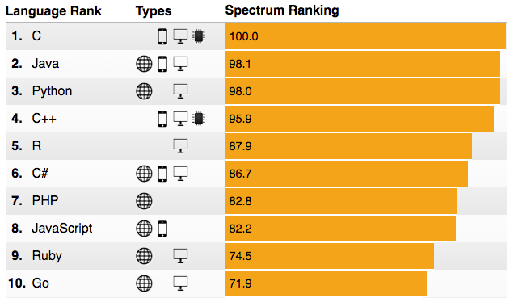
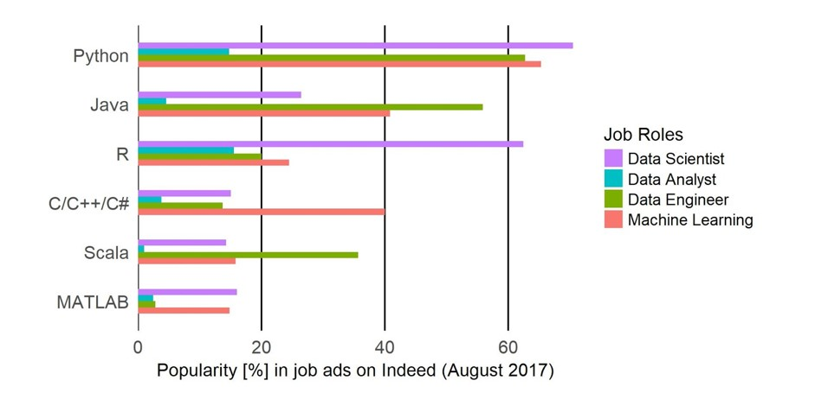
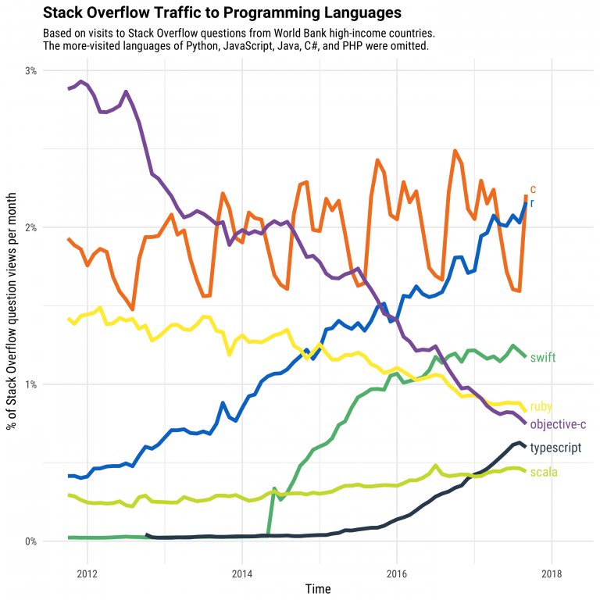
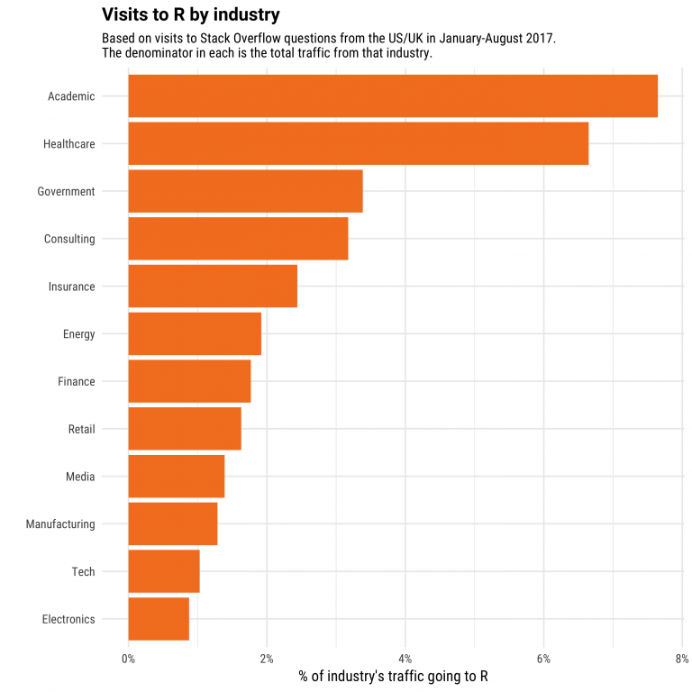
Why R

Slide 7
Why R
Full programming language: customizable, extensible
Open source: contributed packages
Designed for data analysis

Slide 8
Why R
Support for reproducible analysis
Widely used
R Community

Slide 9


R Community
#rstats
RStudio Community https://community.rstudio.com/
R Bloggers https://www.r-bloggers.com/
R User Group Nepal https://www.r-nepal.org/

Slide 10
Things to Know About R

Slide 11
Things to Know
You can't "learn R"
You learn the basics
and learn how to learn more
Notes:
I learn new things, and better ways to do things, nearly every time I use R -- this is after over 15 years.
If you follow #rstats on Twitter, you'll see even prominent members of the R community asking questions about how to do things or how to do them better
R is constantly evolving = new features and functionality, but you can't know everything.

Slide 12
Things to Know
It's expected that you'll
install and use additional packages
Notes:
In this workshop, focused on core R functions — called base R, with just a few exceptions to learn how to use packages. Why? 1) foundation, 2) learn how to read other people's code. I tend to use other packages when doing my own analysis — tidyverse set of packages, which includes dplyr for data manipulation and ggplot2 for visualization, among others.
Packages are open source and user contributed → use established packages or evaluate quality

Slide 13
Things to Know
There are multiple ways
to do most things
Some ways are better than others (efficient)

Slide 14
Things to Know
You can, and often will, have more than one dataset open in R
at the same time
Notes:
dataset = csv file or similar contained set of data; also have multiple variables defined and hanging around

Slide 15
Things to Know
Run R in multiple ways:
Interactively: R console, RStudio, R Notebooks, Jupyter Notebooks
Batch jobs
Recently it got on cloud as well

Slide 16

R packages

Slide 17
Installing Packages
RCRAN network
install.packages(“tidyverse”) #install the packages
library(tidyverse) #load the packages
Bioconductor
if (!requireNamespace("BiocManager"))
install.packages("BiocManager")
BiocManager::install()
BiocManager::install(c("GenomicFeatures", "AnnotationDbi"))
Github
library(devtools)
devtools::install_github("strengejacke/sjPlot")

Slide 18
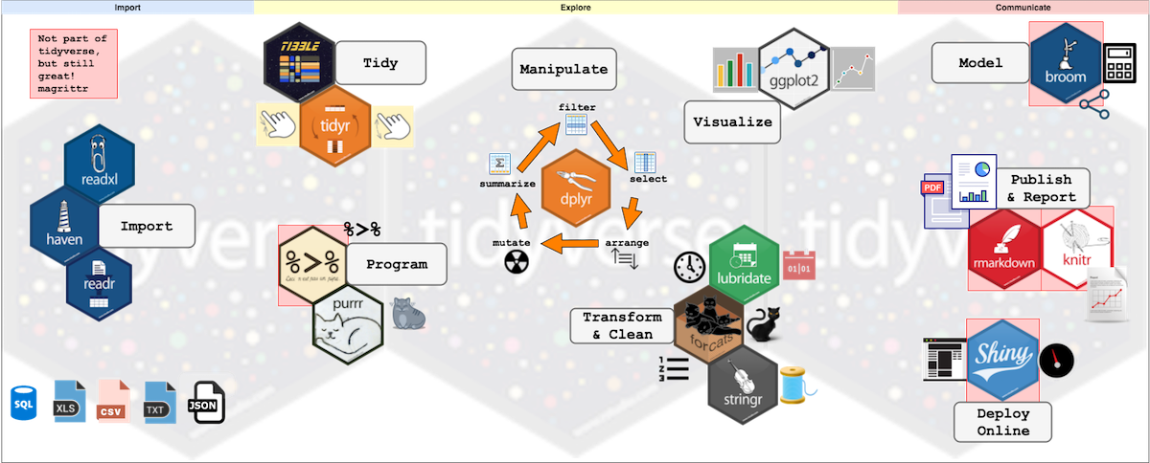

Slide 19
Install and Download
https://github.com/prabinrs/intro_RQDA

Slide 20
2. Coding
One or more coder performs inductive data analysis together, by highlighting the text and clicking “Mark” (“Unmark”) to do (undo) the coding
Other analyst(s) critiques the coding results; reconcile differences in interpretation
Increased reliability and accuracy of data interpretation
Ease of capturing new, unexpected insights through re-coding of data
Possible mechanical errors for inexperienced users
Possible loss of reflexivity or de-contextualizing data

Slide 21
Code and Categories
Inductive coding or Open Coding (Strauss and Corbin, 1990; Gioia et al. 2013)
  Code a textual unit that is close to (i.e basic or lowest level) the data without being predicated on any theory.
  Eg “they used my debit card to charge amounts I never authorized” : code “Monetary Loss”
Deductive Coding: (Fereday and Muir-Cochrane, 2006; Bazeley and Jackson, 2013)
- Categories are coded based on established concept, variables or theories
Eg “the customer service department doesn’t work well with the technical support and that’s why they took six months to solve my technical problems; Code “Market Orientatin” (based on Jaworki and Kohli, 1993)

Slide 22
Create/Open Project
Add Text Files
Other necessary settings

Slide 23
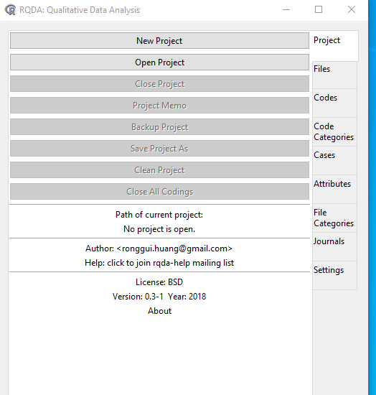
New Project

Slide 24
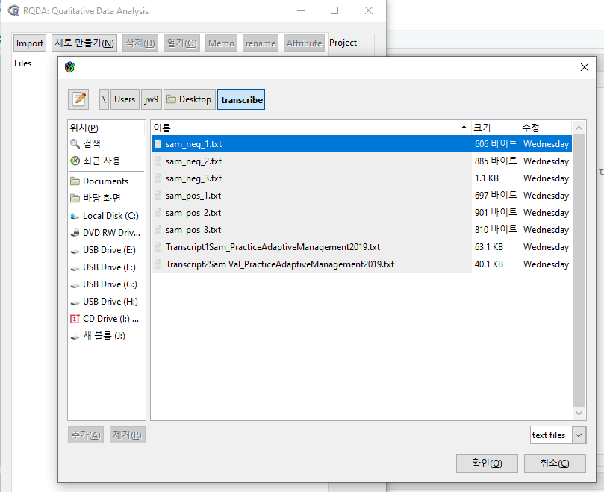
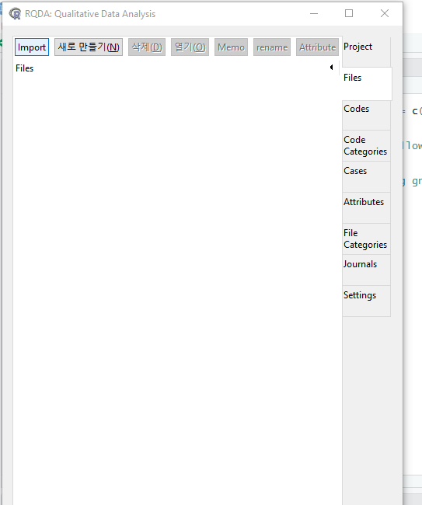
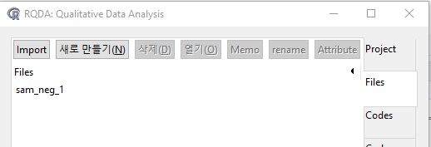
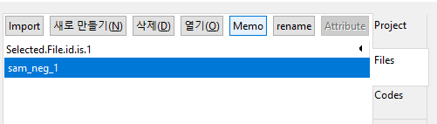
Import Files

Slide 25
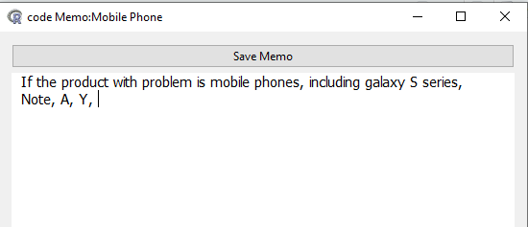
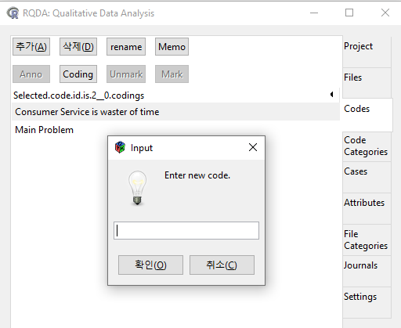
Codes

Slide 26
3. Data Attributes
Click “Attributes” and record key data attributes (e.g. data sources, informants’ demographics, dependent variables)
Click “Memo” to write memos for each case
Allow easy capture of meta information of the data and attributes of informants
Memos can be copied-and-pasted to a Word processor to aid data analysis
- that coders add data attributes or memos to enrich understanding
- enables users to add variables to individual files to show a subset of files and to perform statistical analysis on attributes.
Eg:
Attributes: Type of File,
Memo : Interview with p07 was conducted in presence of her colleagues and seniors.

Slide 27
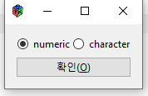
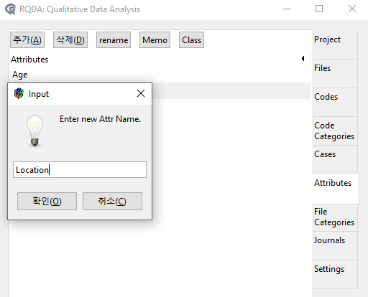
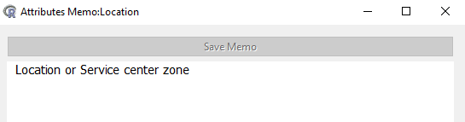
Attributes

Slide 28
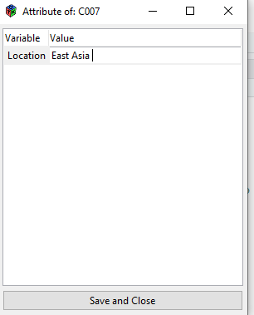
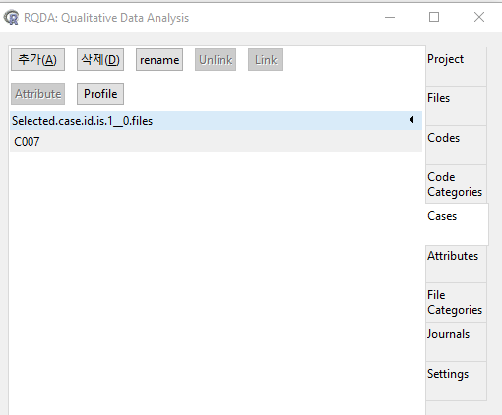
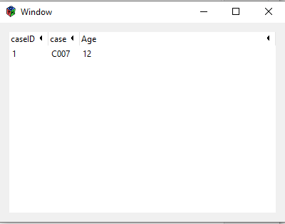
Cases

Slide 29
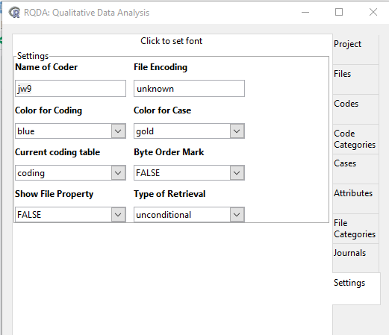
Settings

Slide 30
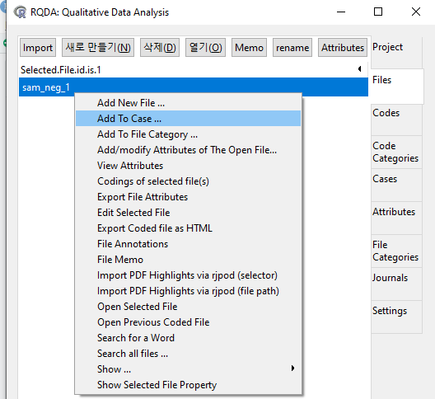
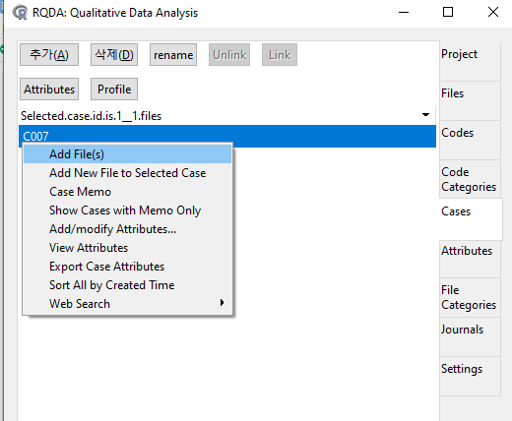
Add File to case

Slide 31
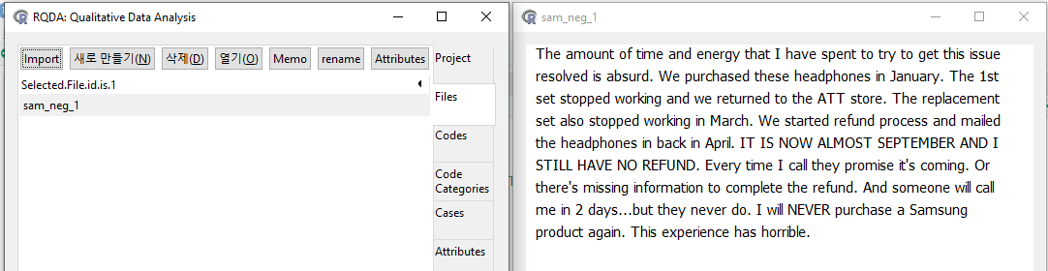
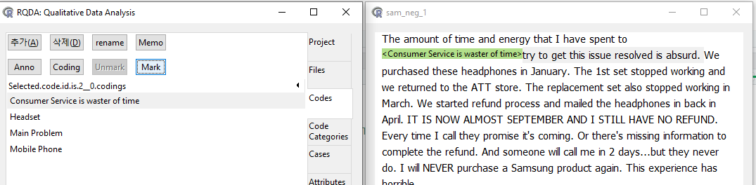
Coding

Slide 32
4. Codes Abstraction
Use “Add To” button to assign all first order codes to second-order code categories
To create third-order code categories, copy and paste all codes and re-arrange them using color font with Excel
Based on Constructivist theory-building Process
A highly systematic way of aggregating codes to a higher level of meaning
Challenging to aggregate too many first-order codes (thousands of codes) to second-order codes
Abstraction to Second Level categories i.e after coding completion, first level codes can be aggreagated into higher-level code categories
Eg. “they used my debit card to charge amounts that I never authorize” and “this faulty laptop means I couldn’t work for four days” can be aggregated to a higher-level concept called “monetary loss”
Notes:
Each of coded categories can be amended by clicking “Rename” button or Detleted by clicking “Delete”

Slide 33
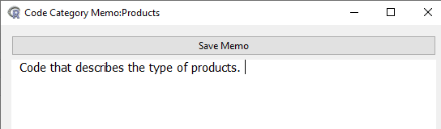
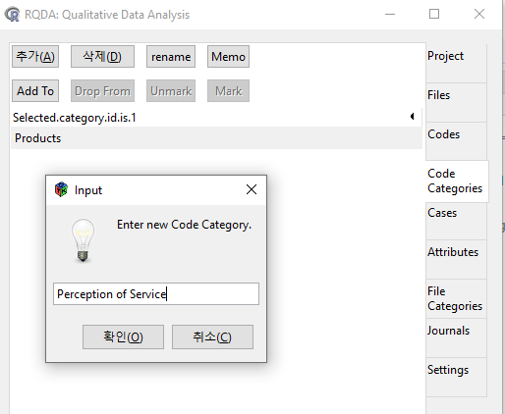
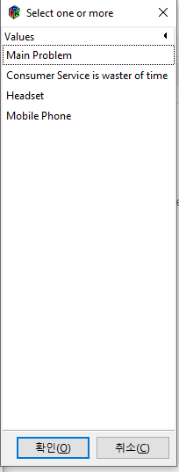
Code Categories

Slide 34
5. Codes Plotting and Sharing
Select all second-order using cursor, right click and press “Plot selected Code categories”.
Produce images of networks of codes
Can re-arrange network codes using various network plot models (e.g
Allows User to visualize the coding results, enhance the data interpretation and analysis process.

Slide 35
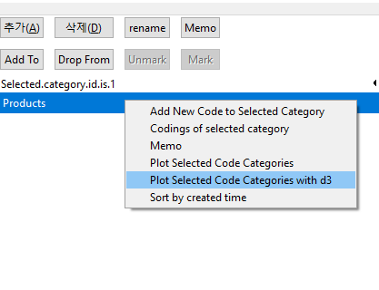
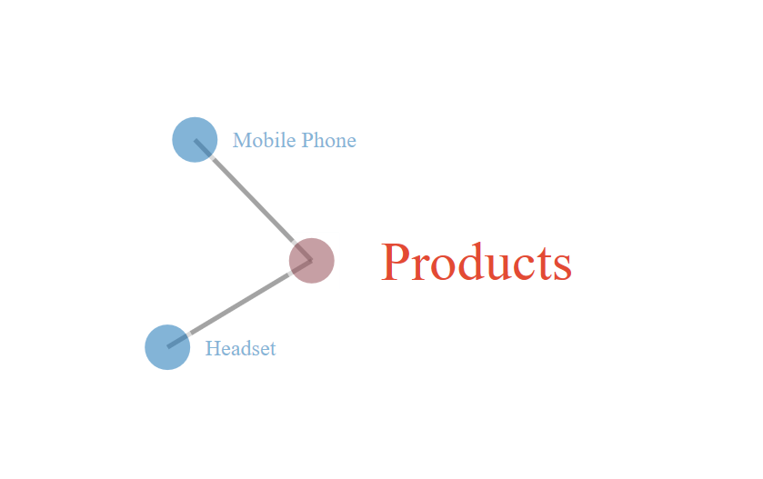

Slide 36
6. Theory Building
Identify the relationships among themes / concepts / variables that emerged to create a process mode.
This is manual process that can only be done using human interpreter.

